Slide 1
Object Tracking and Kalman Filtering
Last updated: 20-5-24
Solem, J. E., 2012. Programming Computer Vision with Python: Tools and algorithms for analyzing images. "O'Reilly Media, Inc.“ (Ch. 10).
Szeliski R., Computer Vision - Algorithms and Applications, Springer, 2011 (Ch. 7).

Slide 2
Introduction to Object Tracking
Object tracking is a critical task in computer vision, involving the continuous observation of moving objects in a sequence of frames.
This capability is fundamental in various applications like video surveillance, human-computer interaction, traffic monitoring, and augmented reality.

Slide 3
Challenges in Object Tracking
Variability in Appearance: Objects can change in appearance due to changes in lighting, perspective, and occlusion.
Motion Dynamics: Objects can move unpredictably, and tracking algorithms need to predict future positions accurately.
Real-Time Processing: Many applications require tracking to be performed in real time, imposing constraints on computational resources.

Slide 4
Common Approaches to Object Tracking
A couple of basic but impractical methods:
a. Frame Differencing
This technique involves subtracting consecutive frames to detect changes in the scene, which are attributed to moving objects.
It's highly sensitive to lighting changes and does not provide information about the object's identity.
b. Background Subtraction
This method models the static background of a scene and subtracts it from the current frame to detect moving objects.
It requires a relatively static background and struggles with dynamic changes in the scene.

Slide 5
Kalman filtering for object tracking
c. Kalman Filter
These are predictive models that estimate the future location of an object based on its previous states, using a form of feedback control to minimize error.
We will discuss this method in detail.

Slide 6
Common Approaches to Object Tracking
Kalman Filtering is an algorithm that provides estimates of some unknown variables (e.g., an object’s position and velocity in an object tracking application) given the measurements observed over time (e.g., object’s position based on an object detection model).
The set of unknown/latent variables are called the state of the object.
These estimates tend to be more accurate than those based on a single measurement alone because the filter optimally combines a series of measurements and predictions.

Slide 7
Working Principle of Kalman Filtering
Kalman filtering operates in two main steps:
Prediction: Based on the current state and a motion model, predict the state at the next time step.
See next slide for a couple of example motion models.
Correction (Update): Once a new measurement is obtained (may be a noisy measurement), correct the predicted state to better match the observed measurement.
The updated state has the effect of both the predicted and the observed state.
This process is repeated iteratively to continuously track the object's state over time.

Slide 8
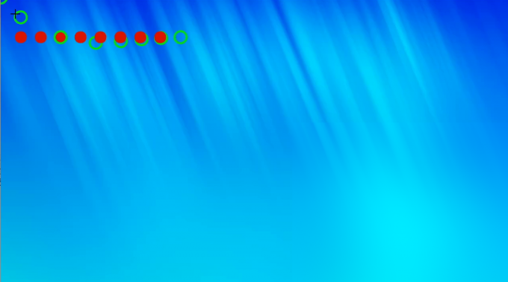
Demonstrating the predicted state of an object
Actual ball position
Predicted ball position

Slide 9
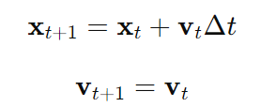
Common Motion Models
1. Constant Velocity Model:
Assumes that the object's velocity remains constant over time.
State vector typically includes position and velocity.
Equations:
where 𝑥_{𝑡}​ is the position, 𝑣_{𝑡}​ is the velocity, and Δ𝑡 is the time step.

Slide 10
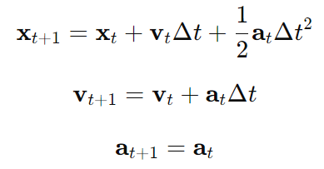
Common Motion Models
2. Constant Acceleration Model:
Assumes that the object's acceleration is constant.
State vector typically includes position, velocity, and acceleration.
Equations:
where 𝑎_{𝑡}​ is the acceleration.

Slide 11
Example Scenario: Tracking a car object
Assuming a constant-velocity motion model

Slide 12

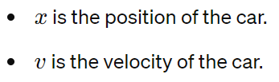
Example Scenario: Tracking a car object
Assume: We want to track the position and velocity of a car moving on a straight road using a Kalman filter. Assuming a constant velocity motion model, let’s define the state and measurement in this case:
State
The state in a Kalman filter represents the set of variables that define the condition of the object being tracked at any given time. In our example, the state of the car can be defined by its position and velocity.
Let's define the state vector as:

Slide 13
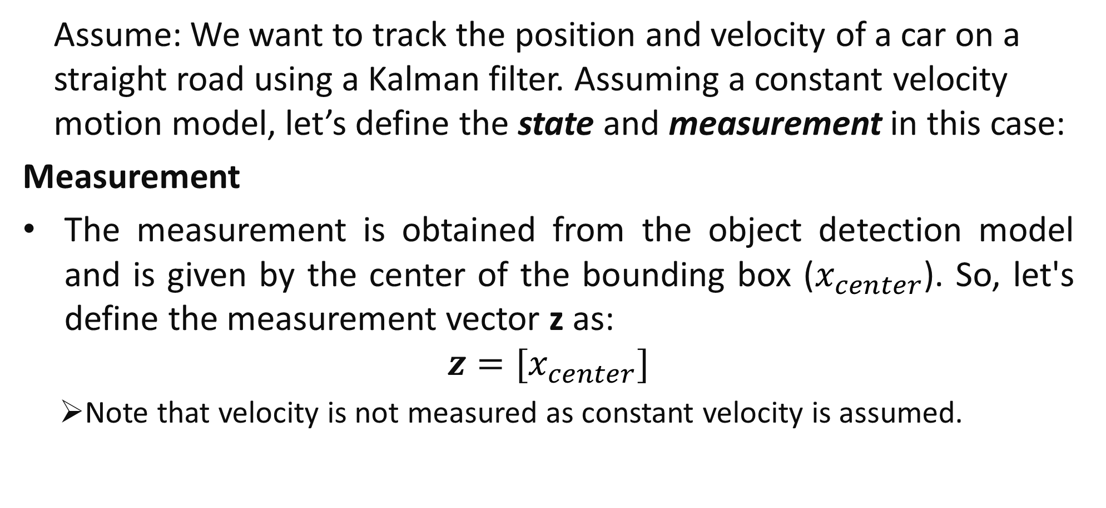
Example Scenario: Tracking a car object
Assume: We want to track the position and velocity of a car on a straight road using a Kalman filter. Assuming a constant velocity motion model, let’s define the state and measurement in this case:
Measurement
The measurement is obtained from the object detection model and is given by the center of the bounding box ($x_{center}$). So, let's define the measurement vector z as:
$$z=[x_{center}]$$
Note that velocity is not measured as constant velocity is assumed.

Slide 14

Example Scenario: Tracking a car object
Kalman Filter in Action
The Kalman filter operates in two main steps: prediction and update.
Prediction Step:
State Prediction: Using the current state (position and velocity) and the constant velocity motion model, we can predict the next state of the car as:
where Δ𝑡 is the time interval between measurements, and x_{k|k-1} is the object’s estimated state at time k, given its state at time k-1.

Slide 15
Example Scenario: Tracking a car object
Kalman Filter in Action
The Kalman filter operates in two main steps: prediction and update.
Update Step:
Measurement Update: The predicted state is corrected using the actual object position (measurement) obtained using the object detection model.
For example, if the object detection model reports the position x_{center}​, we update the predicted position 𝑥 to be closer to x_{center} ​.

Slide 16
Tracking a car object (A concrete example)
For more clarity, let’s create a concrete Example with Numbers, e.g. let's say at time 𝑡=0:
The car's initial state is: 𝑥₀=0 meters, 𝑣₀=10 meters/second.
The new object position measurement: 𝑥_{center}=8 meters.
1. Prediction Step:
Predicted position after 1 second (or in the next video frame): 𝑥_{1∣0}=0+10×1=10 meters.
Predicted velocity: 𝑣_{1∣0}=10 meters/second (as constant velocity is assumed)

Slide 17
Tracking a car object (A concrete example)
2. Update Step:
Using the actual object position measured by the object detection model, we correct the predicted position:
The Kalman filter combines the predicted position (10 meters) and the new measured object position (8 meters) to get a new estimate. Suppose the filter assigns equal weights to both, such that the new estimate is 9 meters.
Since the velocity is not measured directly, the velocity update relies on the prediction model (constant velocity) and does not change.

Slide 18
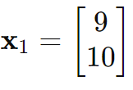
Tracking a car object (A concrete example)
Thus, the updated state after prediction and update steps in the next frame could be:
This process continues iteratively, refining the position and velocity estimates using new measurements from the measured object state.

Slide 19
Tracking a car object (A concrete example)
Summary
In this example, the state vector includes the position and velocity of the car, while the measurement vector consists of the position measurement from the object detection model.
The Kalman filter predicts the next state based on the motion model and updates the predicted state using the position measured by the object detection model.
This iterative process enhances the accuracy and reliability of tracking the car's position and velocity over time.

Slide 20
How Kalman filtering helps object tracking?
1. Scenario: Occlusions
Problem:
The tracked object might get temporarily occluded by another object, leading to a loss of measurements.
For example, a car might pass behind a large truck, making it invisible to the camera for a short period.
Kalman Filter Solution:
During the occlusion, the Kalman filter continues to predict the object's state based on its motion model, providing an estimated position even when the measurements are unavailable.
Once the object reappears, the Kalman filter updates the state based on the new measurements, seamlessly continuing the tracking.

Slide 21
How Kalman filtering helps object tracking?
2. Scenario: Sensor Noise
Problem:
Inconsistent and noisy measurements from sensors like cameras can lead to inaccurate tracking.
For example, due to dim light imaging, an object detection might not be able to accurately detect the object of interest.
Kalman Filter Solution:
The Kalman filter uses a weighted average approach to combine the predicted state with the noisy measurements, giving more weight to the predicted state when the measurements are uncertain.
This helps smooth out the noise and provides a more stable and accurate position estimate.

Slide 22
How Kalman filtering helps object tracking?
3. Scenario: Sudden Maneuvers
Problem:
The tracked object might make sudden and unpredictable maneuvers that are not well captured by a simple motion model.
For example, a pedestrian might suddenly change direction or start running.
Kalman Filter Solution:
The Kalman filter can adjust its prediction based on the latest measurements, quickly adapting to the new trajectory.

Slide 23
Another Example Scenario: Tracking a car object
Using optical flow to improve velocity estimation

Slide 24
Example Scenario: Tracking a car object
Assume: We want to track the position and velocity of a car on a straight road using a Kalman filter. Assuming a constant velocity motion model, let’s define the state and measurement in this case:
Using optical flow to improve estimation
In the above example, we assumed constant velocity for the moving object, which won’t always be true.
Optical flow vectors can be used to estimate the car's velocity and improve the Kalman filter's predictions and updates for velocity.
Remember, using optical flow, the motion is represented by vectors that indicate both the direction and the magnitude of movement for each pixel/object.

Slide 25
Example Scenario: Tracking a car object
Assume: We want to track the position and velocity of a car on a straight road using a Kalman filter. Assuming a constant velocity motion model, let’s define the state and measurement in this case:
State
The state in a Kalman filter represents the set of variables that define the condition of the object being tracked at any given time. In our example, the state of the car can be defined by its position and velocity.
Let's define the state vector as:

Slide 26
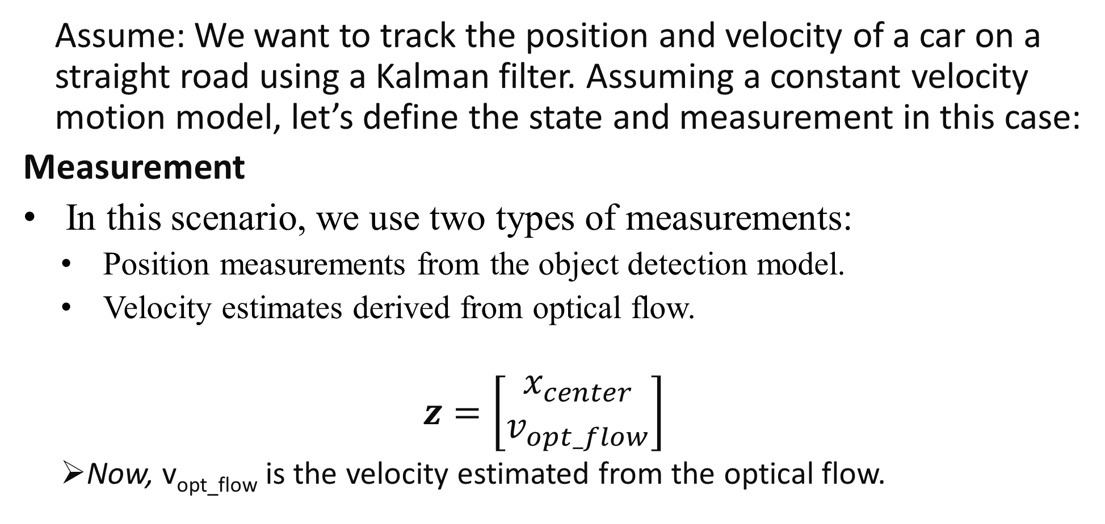
Example Scenario: Tracking a car object
Assume: We want to track the position and velocity of a car on a straight road using a Kalman filter. Assuming a constant velocity motion model, let’s define the state and measurement in this case:
Measurement
In this scenario, we use two types of measurements:
Position measurements from the object detection model.
Velocity estimates derived from optical flow.
$$z=\left[\begin{matrix}x_{center} \\ v_{opt_flow}\end{matrix}\right]$$
Now, v_{opt_flow}​ is the velocity estimated from the optical flow.

Slide 27
Example Scenario: Tracking a car object
Kalman Filter in Action
The Kalman filter operates in two main steps: prediction and update.
Prediction Step:
State Prediction: Same as previous:
where Δ𝑡 is the time interval between measurements, and x_{k|k-1} is the object’s estimated state at time k, given its state at time k-1.

Slide 28
Example Scenario: Tracking a car object
Kalman Filter in Action
The Kalman filter operates in two main steps: prediction and update.
Update Step:
Measurement Update:
Position Update: [same as previous] The predicted state is corrected using the actual object position (measurement) obtained using the object detection model.
Velocity Update: Use the optical flow-derived velocity to update the predicted velocity.

Slide 29
Tracking a car object (A concrete example)
For more clarity, let’s create a concrete Example with Numbers again, e.g. let's say at time 𝑡=0:
The car's initial state is: 𝑥₀=0 meters, 𝑣₀=10 meters/second.
The object position measurement: 𝑥_{center}=8 meters.
Optical flow analysis provides a velocity estimate: 𝑣_{opt_flow}= 9 meters/second.
1. Prediction Step:
Predicted position after 1 second (or in the next video frame): 𝑥_{1∣0}=0+10×1=10 meters.
Predicted velocity: 𝑣_{1∣0}=10 meters/second (as constant velocity is assumed)

Slide 30
Tracking a car object (A concrete example)
2. Update Step:
Using the actual object position measured by the object detection model and the velocity information from optical flow, we correct the predicted position:
Position Update: [same as previous] The Kalman filter combines the predicted position (10 meters) and the measured object position (8 meters) to get a new estimate. E.g., suppose the filter assigns equal weights to both, such that the new estimate is 9 meters.
Velocity Update: Using the optical flow measurement, correct the predicted velocity:
The Kalman filter combines the predicted velocity (10 meters/second) and the optical flow-derived velocity (9 meters/second) to get a new estimate (e.g., 9.5 meters/second).

Slide 31
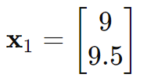
Tracking a car object (A concrete example)
Thus, the updated state after prediction and update steps in the next frame could be:
This process continues iteratively, refining the position and velocity estimates using new measurements from the measured object state.

Slide 32
Tracking a car object (A concrete example)
Summary
Optical flow vectors provide valuable velocity information that can be used to update the car's velocity in the Kalman filter.
By combining position measurements from the object detection model and velocity estimates from optical flow, the Kalman filter can more accurately track the car's position and velocity over time.
This integration enhances the robustness and accuracy of the tracking system.

Slide 33
Conclusion
A simple example in python based object tracking using Kalman Filtering:
https://www.youtube.com/watch?v=3iqRhbXBVRE
https://pysource.com/2021/11/02/kalman-filter-predict-the-trajectory-of-an-object/

